Slide 1
Managing and Navigating WinRMS Session 1: TDAs – Allocations and Distributions
Tabitha Randall, Supervisory Budget Analyst – Salt Lake City
Kari Points, Director Research Operations Iowa City
Antonio Laracuente, Director Field Operations - ORD
June 15, 2021
Dial in: 1 – 404 – 397 – 1596
Access Code: 199 –445 – 3981
Slides in “Handout” Tab

Slide 2
Objectives
4 Sessions
TDAs – Allocations and Distributions including Prior Year – June 15
Salary Management - June 16
How to Manage the Noise in WinRMS – June 22
Setting up Accounts, Expense Transfers and Split Account Transactions – June 23

Slide 3
Presenters
Antonio Laracuente – Director Field Operations, ORD
Kari Points – Director Research Operations – Iowa City
Tabitha Randall – Supervisory Budget Analyst – Salt Lake City
Jamece Petteway – Supervisory Budget Analyst – Durham
Travis Peake – Supervisory Budget Analyst – Portland
Erin Olson – Supervisory Budget Analyst – St. Louis

Slide 4
Poll Question 1
Do you currently have WinRMS installed at your facility?
Please answer the poll question when it appears on the right-hand side of your screen.
Then click the “Submit” button located in the lower right-hand corner

Slide 5
Poll Question 2
If you have WinRMS installed, what is the level of functionality and use?
Please answer the poll question when it appears on the right-hand side of your screen.
Then click the “Submit” button located in the lower right-hand corner

Slide 6
Disclaimers and Thoughts
These are ideas that we are presenting to make WinRMS useful. If you have better ideas or ways to manage, please send those to any of us.
There are many ways to attack WinRMS however the presentations are based on the long term experiences of the users
Do not hesitate to contact any of us to help out
If you do not have WinRMS and would like it, please contact Kashif Iqbal or myself
It takes a few months to get WinRMS going at a station
The larger the station the more effective WinRMS is since it manages many accounts and control points
It takes daily management to make this work
You need to utilize other tools such as VSSC and IFCAP (VISTA) to reconcile and manage

Slide 7
Rules of Engagement
You Allocate a TDA to a Control Point and then you Distribute to an Account
Transactions occur at the Control Point level. WinRMS does not split a transaction among several Control Points
Purchases hit one control point – you have to execute Cost Transfers (EWs, Ebs) to move the cost to another FCP
Salaries hit one control point in FMS – you have to let them hit one FCP in WinRMS then transfer the cost
The Expense Transfer Module is for transferring or distributing costs within one FCP
Orders may hit WinRMS but not yet hit FMS because they are not obligated so you have to account for that when balancing
Salaries can be projected to the whole year or partial
The Administrators Report is a Critical report for you to use

Slide 8
Prior Year (PY) Overview
In October each year, you will close out the previous fiscal year in WinRMS. Once you have closed it out, no more downloads or entries should occur.
When setting up the new fiscal year, you will want to make note that these FCPs are now Prior Year.
The remaining balances from each PY FCP will need to be entered. This can be found by either looking at your previous fiscal year ending balance in WinRMS or from the Status of Allowance (SOA - FMS).
To enter the remaining balance for each PY FCP in the new fiscal year, you will want to allocate the amount to the FCP and then distribute to the accounts.
I recommend no longer downloading the PY FCP and doing manual entries of any adjustments/items.

Slide 9
How to Setup PY FCPs
When setting up the new fiscal year, the FCPs will automatically transfer over to the new year.
You will want to delete the FCPs that are no longer in use (Last year’s PY). This can be done by going to Find -> Find Control Point -> And then clicking on the FCP and selecting Remove Control Point.
For the All Other FCPs that are now PY, you will want to edit them to make note of this and change the description to state PY. This can be done by going to Find -> Find Control Point -> And then clicking on the FCP and selecting Change Control Point.
For the salary FCPs that don’t change numbers each year, you want to make sure you designate the PY FCP and still have it listed as a FCP in WinRMS. For example, CY would be FCP 403 and PY I designate as P403.

Slide 10
Set-up of PY FCP

Slide 11
Set-up of PY FCP
Can see designation of PY Salary FCP

Slide 12
Set-up of PY FCP
Can change or remove FCP

Slide 13
How to Figure out the number to Put in
WinRMS:
Once the previous fiscal year is finalized in WinRMS, you can pull a report with the remaining balances. This can be done couple ways.
Reports – Go to the Administrators Summary Report and look at the final amount in the Account Balances report. It will give the cumulative balance remaining in each FCP.
Click on the Control Point on the home page in yellow and then click on either Summary Status or Detail Status in purple. This will show you the Total Funds Remaining.
Status of Allowance
On the SOA, look at the FMS Unobligated balance for each FCP.

Slide 14
WinRMS Reports

Slide 16
Administrators Summary Report – Account Balances

Slide 17
WinRMS FCP Balance

Slide 18
WinRMS Summary Status

Slide 19
WinRMS Detail Status

Slide 20
How to Figure out the number to put in (cont.)
The previous slides show how to determine the remaining amount for each FCP. You also need to know the accounts that the PY funds need to be distributed to.
A determination needs to be made of the amount of PY funds that will need to be distributed to each account in WinRMS. This can be done by pulling the Account Status Report and looking at the remaining balances for each account.
Go to Reports -> Status Reports -> Account Status Report -> You can then select all accounts or select the individual account that you want to view.
OR
You can click on the individual account on the home page and click on Summary Status or Detail Status in purple.
At the bottom right of either report, it will give you the account balance.

Slide 21
Account Balance Report

Slide 22
Account Balance – Summary or Detailed Status
And then click Summary Status or Detail Status for Account Balance.
Click on Account you want to view in pink

Slide 23
How to Allocate PY
The first step in entering the PY balances for each FCP is to allocate the amount remaining to each FCP.
This can be done by going to Add -> Add Funds Allocation.
You will want the total amount of PY across all FCPs in order to do the Funds Allocation.
The Funds Allocation then breaks up the total amount across the FCPs.

Slide 24
How to Allocate PY (cont.)

Slide 25
How to Allocate PY (cont.)

Slide 26
How to Distribute PY
Once the funds are allocated to the FCPs, you then need to distribute them to the correct accounts in WinRMS.
This can be done by going to Add -> Add Funds Distribution.
The amount that was allocated to each FCP will be entered and then it will be distributed amongst the accounts.
You will need to do complete a Funds Distribution for each PY FCP that had funds remaining.

Slide 27
How to Distribute PY (cont.)

Slide 28
How to Distribute PY (cont.)

Slide 29
How to Distribute PY (cont.)
You can see each FCP has its own Distribution

Slide 30
Current Year - ITA
How to pull the ITA
Loading the ITA into WinRMS
Do you load the full year or partial?
Personnel versus All Other versus Travel
How to balance the ITA
How to update with new TDAs

Slide 31
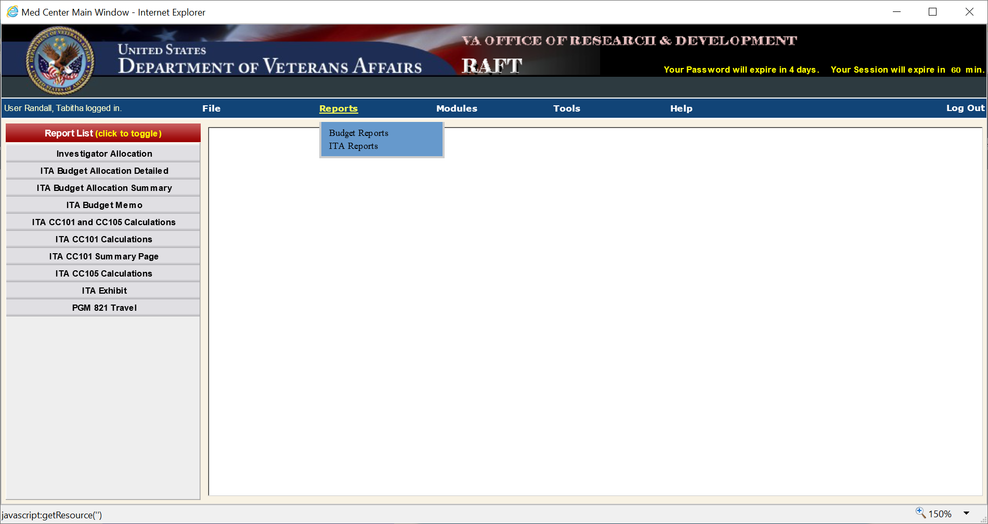
-Hover over Reports
-Select ITA Reports
-Select ITA Budget Memo
Notes:
Good Afternoon! My name is Tabitha Randall and I am hoping to assist you on getting started in RMS with the allocations and distributions. To have what you need to get started in RMS, you first need to access the RAFT for reports. RAFT is an extremely important tool to utilize for putting in the correct information.
Once you log in to RAFT, hover over Reports and Select ITA Reports. A menu will pop up on the left. Select ITA Budget Memo.

Slide 32
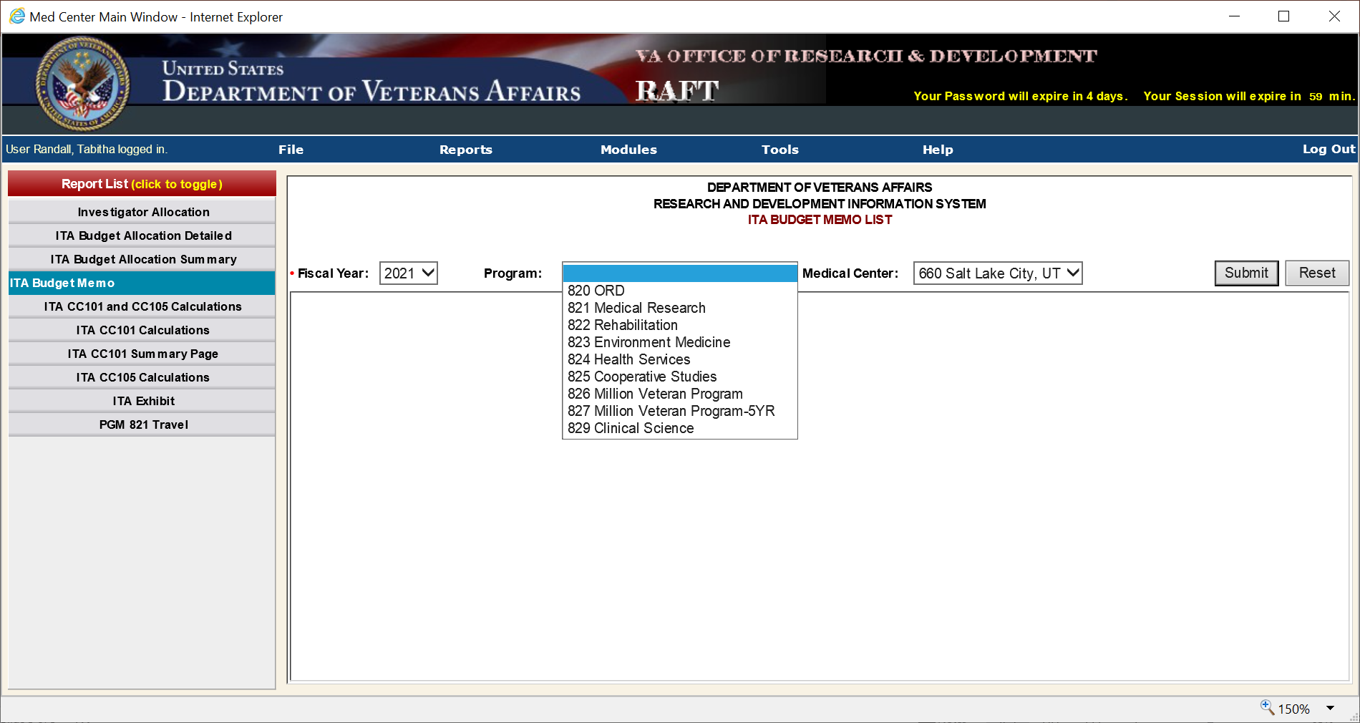
-Select Fiscal Year
-Select the Program
-Select your Medical Center
-Click Submit
Notes:
After you’ve selected ITA Budget Memo, the following options pop up: Fiscal Year, Program, and Medical Center. Select the fiscal year. For Program you can leave the selection black if you’d like to see everything all at once, or you can select program by program. Then select your medical center if it doesn’t already automatically pop up. Click submit.

Slide 33
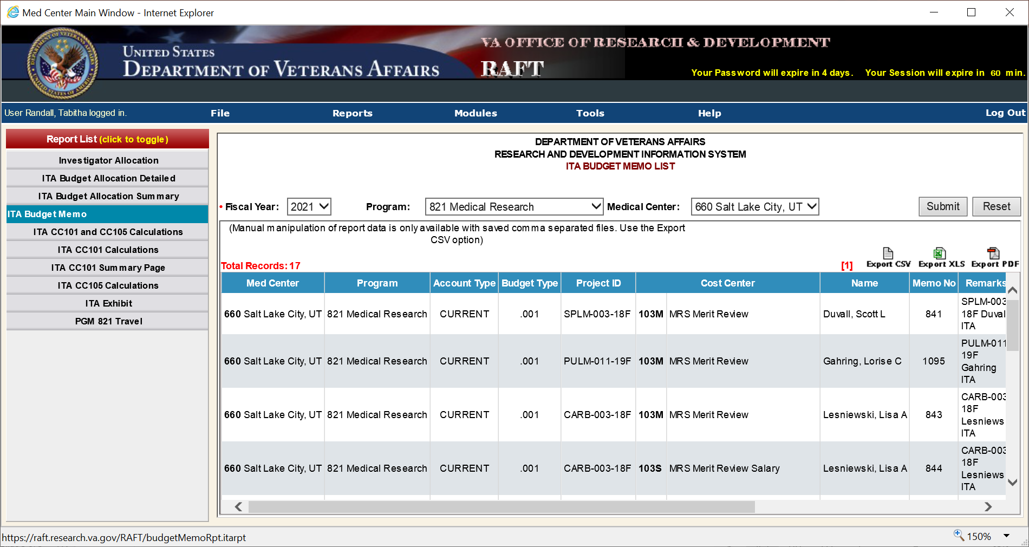
Select preferred method to view the report
Notes:
Once you’ve clicked submit, this is what you will see. To view it better you have the option to export it in either CSV, Excel, or PDF. I prefer to view in PDF, but I do know several prefer Excel due to the availability to edit or sort the cells. Select your option you prefer, and it should pop up for you. My examples will be in PDF.

Slide 34
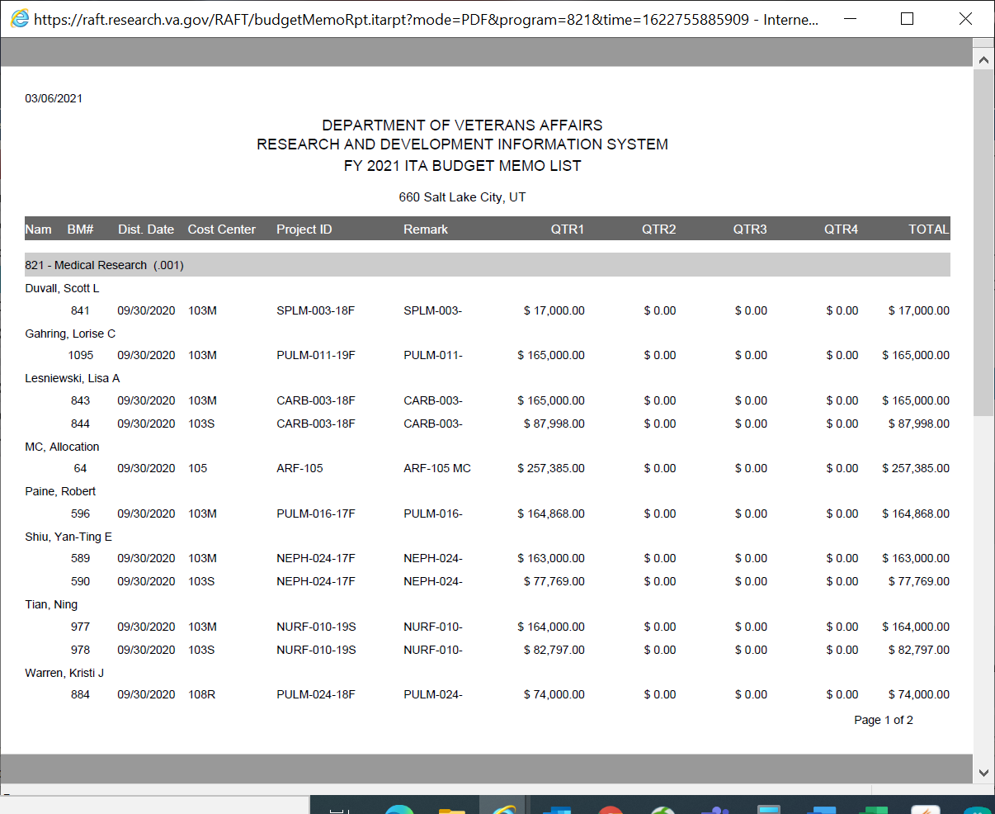
Salary
Notes:
Here is the PDF I see for the ITA Budget Memo for my Program 821. If the PI receives salary as part of their study, it will be listed as a second line under their name.

Slide 35
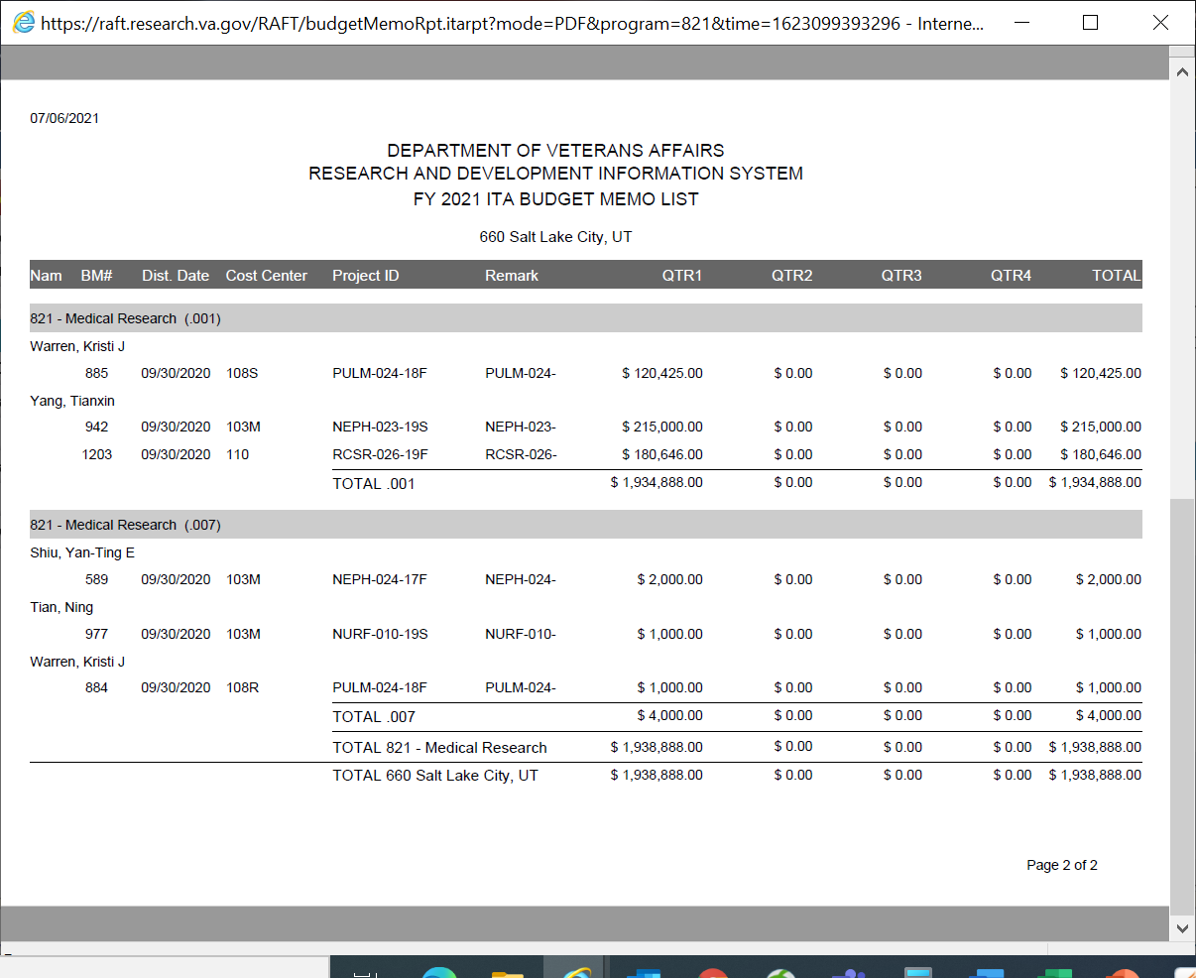
Preliminary Total
Travel Allocations
Total originally allocated to my program 821
Notes:
Here’s the second page to my report. You will see a preliminary total for funds in the program, and then separately listed is travel allocations, and at the bottom the total allocated amount that is to arrive in this program 821.

Slide 36
Preparing to enter your Allocations and Distributions
Based on your report, you will need to calculate what you plan on placing in your Salary, All Other, and Travel Fund Control Points
To figure out your salary information, you can either use the amount listed on the second line in your reports, or you will need to know if there are multiple salaried employees on the project. There are a few ways you can get this information:
If you’ve already run a download with RMS, you can get the projected salary coverage for the year and use that number
If you get payroll reports from finance, you can project the fiscal year through the pay periods as an estimate
You can use the previous year’s information and adjust later
If you have access to your PI’s Budget for their project, you can use those numbers
Notes:
Based on your report, you will need to calculate what you plan on placing in your Salary, All Other, and Travel Funds control Points. There are multiple ways to figure out your salary numbers and they are listed here.

Slide 37
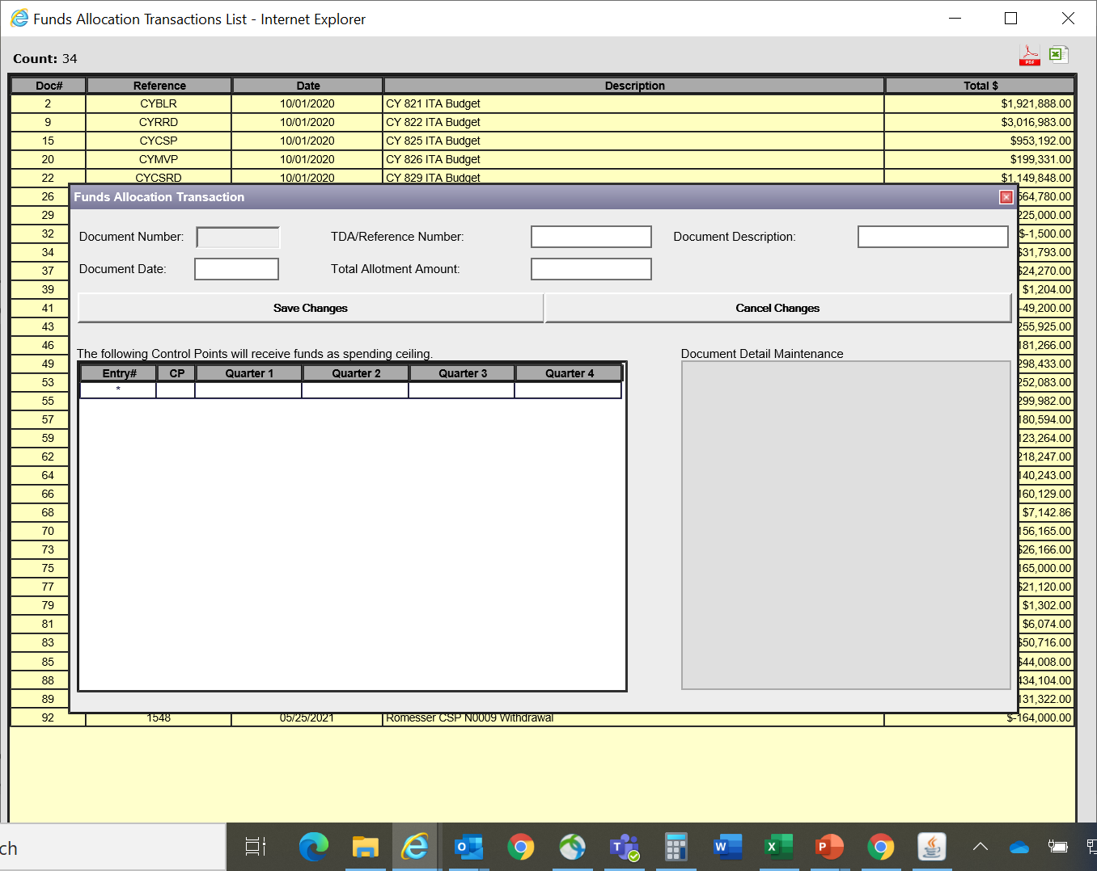
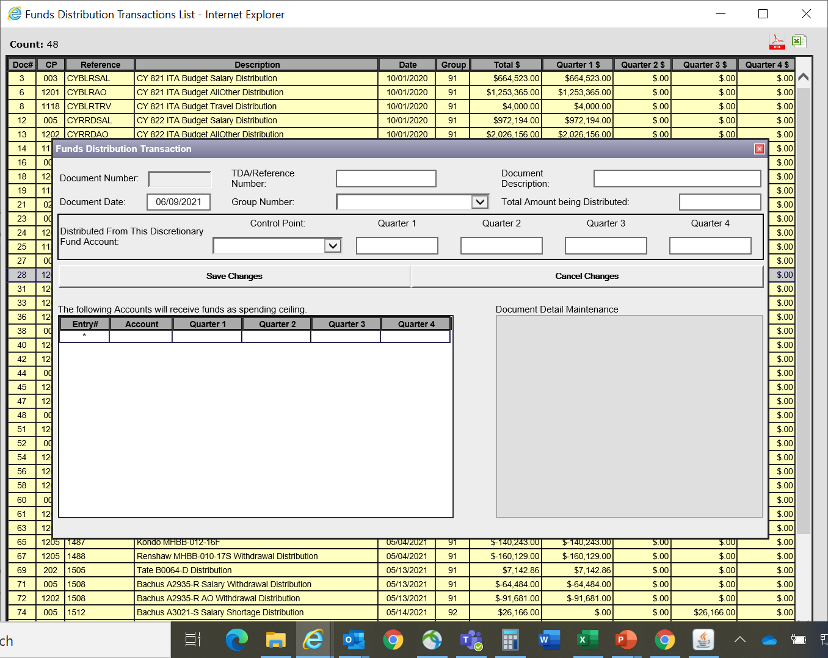
**These two windows look similar. Make sure you are in the window you plan on inputting your data entry!
Notes:
Before we start in RMS I want to point out that the windows look very similar, so make sure you’re in the window you mean to be using. The best way (or my preferred way) to go about doing the data entry is to do your allocations before your distributions.

Slide 38
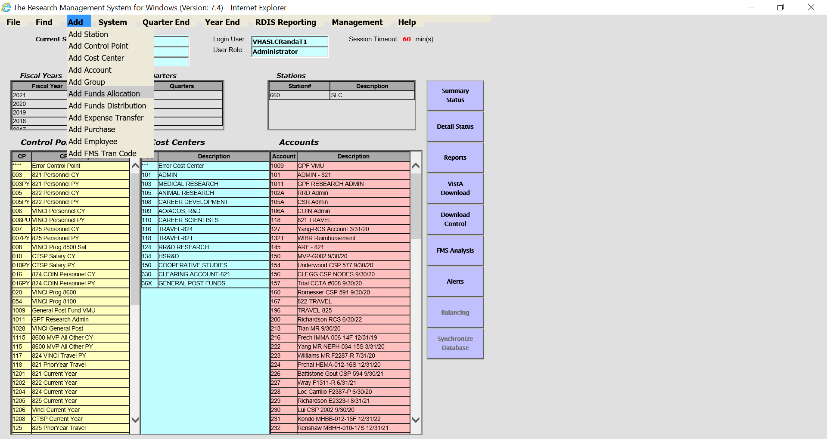
-Click on Add
-Select Add Funds Allocation
Notes:
Ok, let’s get started in RMS. Go to the top of the program, click on Add and select Add Funds Allocation.

Slide 39
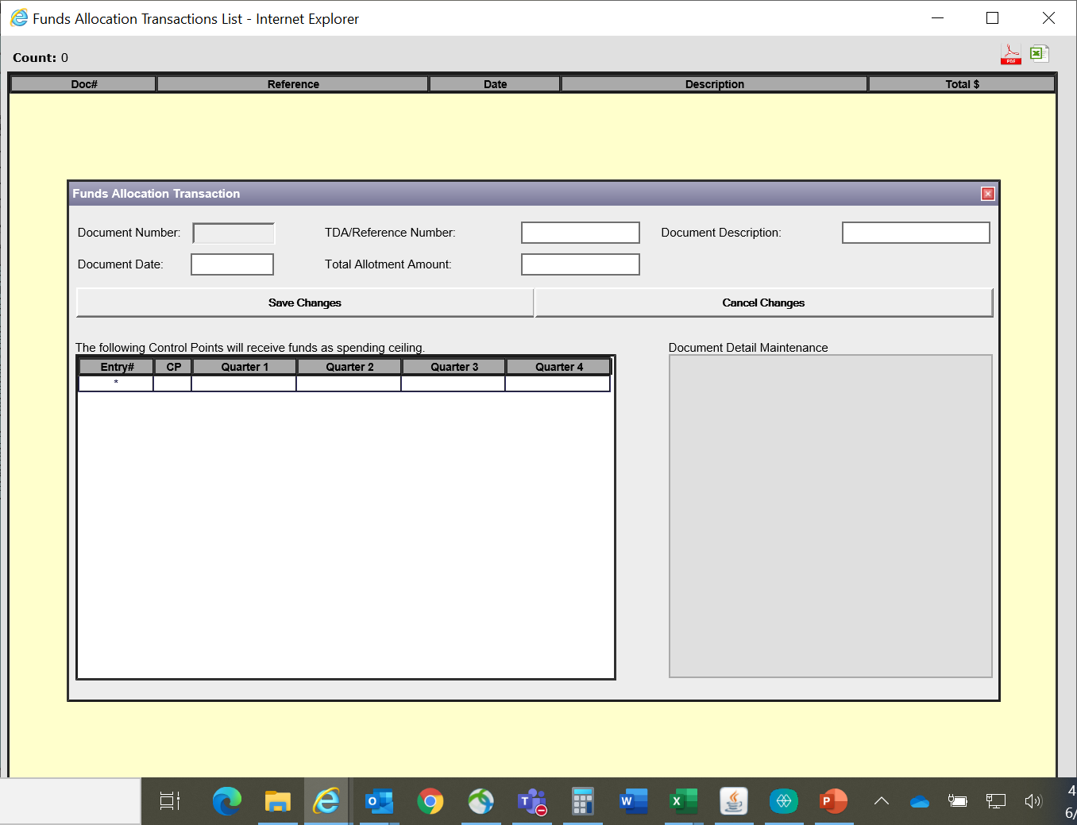
Document Number: Automated when document is saved
TDA/Reference Number: TDA or reference code that you will use for this document
Document Description: Reference to the document, i.e.: PI name, Project ID from TDA
Document Date: Date that the TDA came in
Total Allotment Amount: Total amount you are putting on this document.
Notes:
Once you’ve selected Add Funds Allocation, this pop-up box should appear to you. You’ll see Document Number is black. That number is automated once you save your document, and that number is not changeable. Your TDA or Reference Number is self explanatory, you’d place your TDA number there or a short reference code that you’d understand what it means in correlation with this document. Document Description is a short reference to the document. I often put the information listed on the TDA (PI name, Project ID). Document Date is the date the TDA came in. And the Total Allotment amount is the total amount you plan on putting into the program in this particular document.

Slide 40
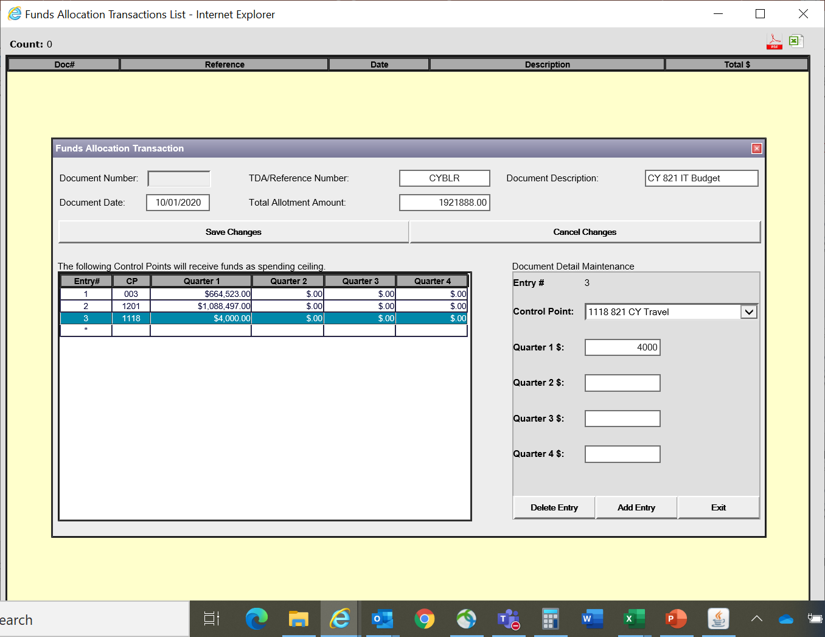
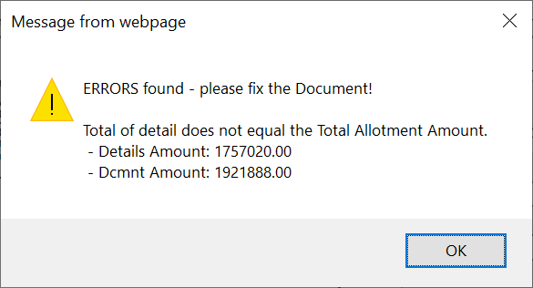
FUND ALLOCATION
Input your information based off of the ITA Memo: your total for the program, and then separate by All Other, salary, and Travel. Make sure those amounts equal the total allotment amount or you will get the alert below.
Notes:
The information I have placed in here is based off of my ITA Budget Memo Report we viewed a few slides ago. This is where it is divided between All Other, Salary, and Travel. Since this is from the ITA MEMO, I don’t have a traditional TDA number, so I used CYBLR, for Current Year BLRD Program. I use this same format for RRD, CSR, CSP and so forth for the ITA memo entries, and I also use the beginning of the year as the date. As you can see, there is also an alert here. RMS is very good about having alerts pop up if the information you’re inputting does not add up. The alert for this is because I input an incorrect amount across the quarters and those numbers did not add up to the Total Allotment Amount.

Slide 41
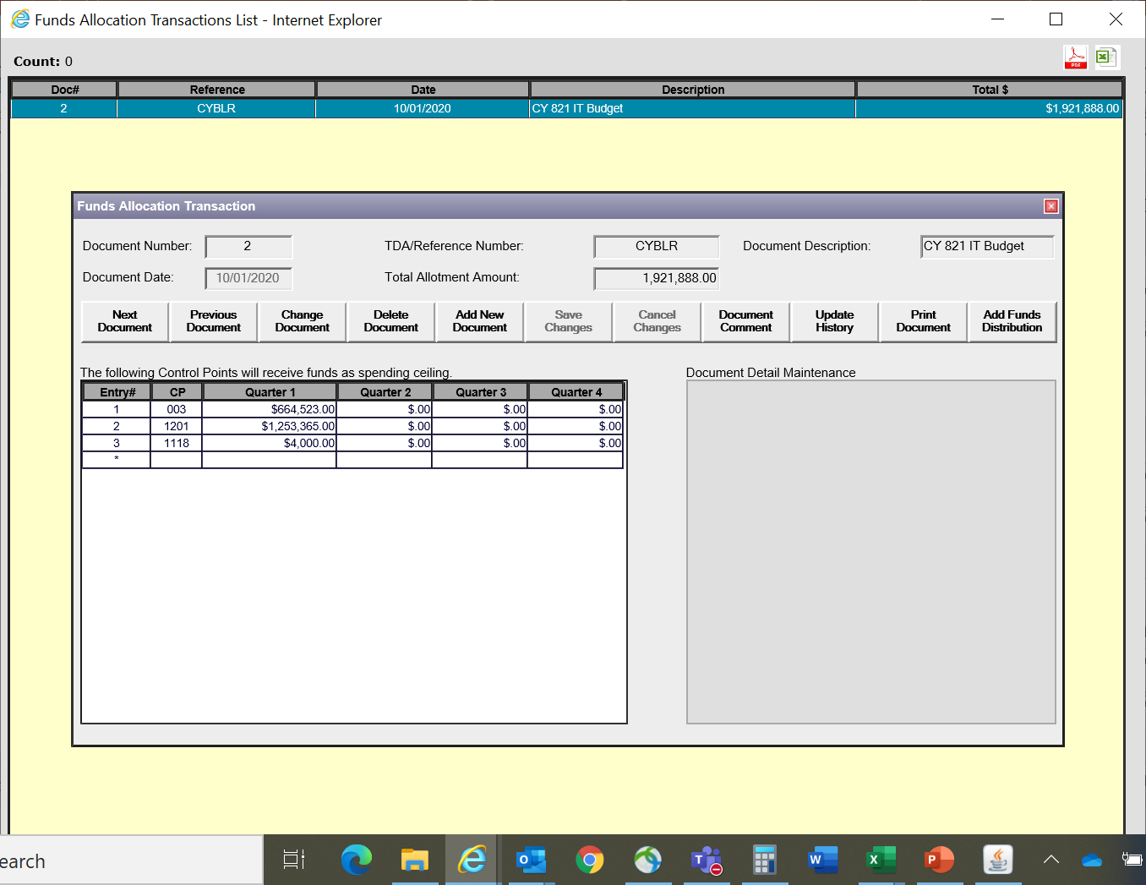
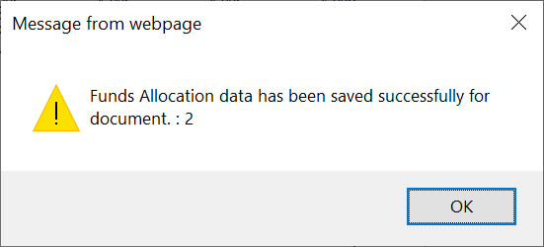
This is how it looks after your information is correct and you’ve hit “Save Changes”.
The pop up below will alert you to the document number.
You can see this document is now viewable on the Allocation Transactions List.
**Now you want to do your distribution. You can either go to the main page, OR click on this button
Notes:
Once I corrected my number and clicked save changes, the pop up comes up saying it was saved, and the document number is updated. It is also viewable on your Funds Allocation Transactions List.

Slide 42
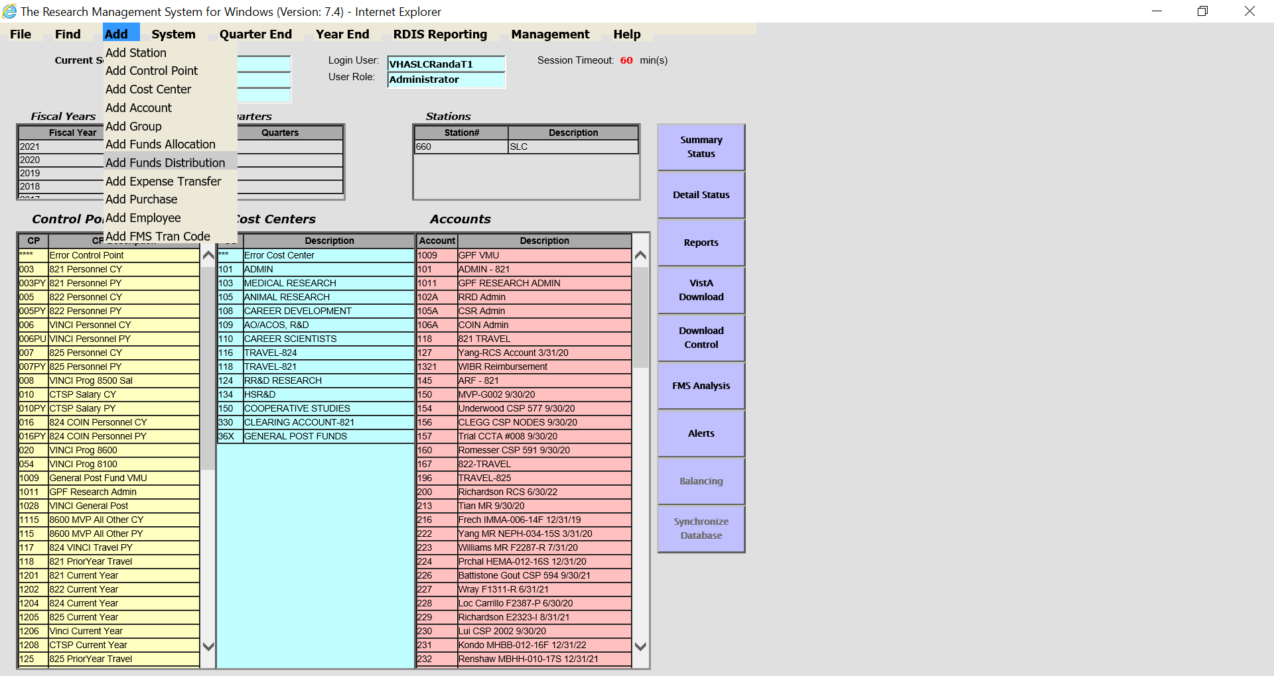
-Click on Add
-Select Add Funds Distribution
Notes:
If you’ve decided to go back to the main page, Click on Add, and select Add Funds Distribution.

Slide 43
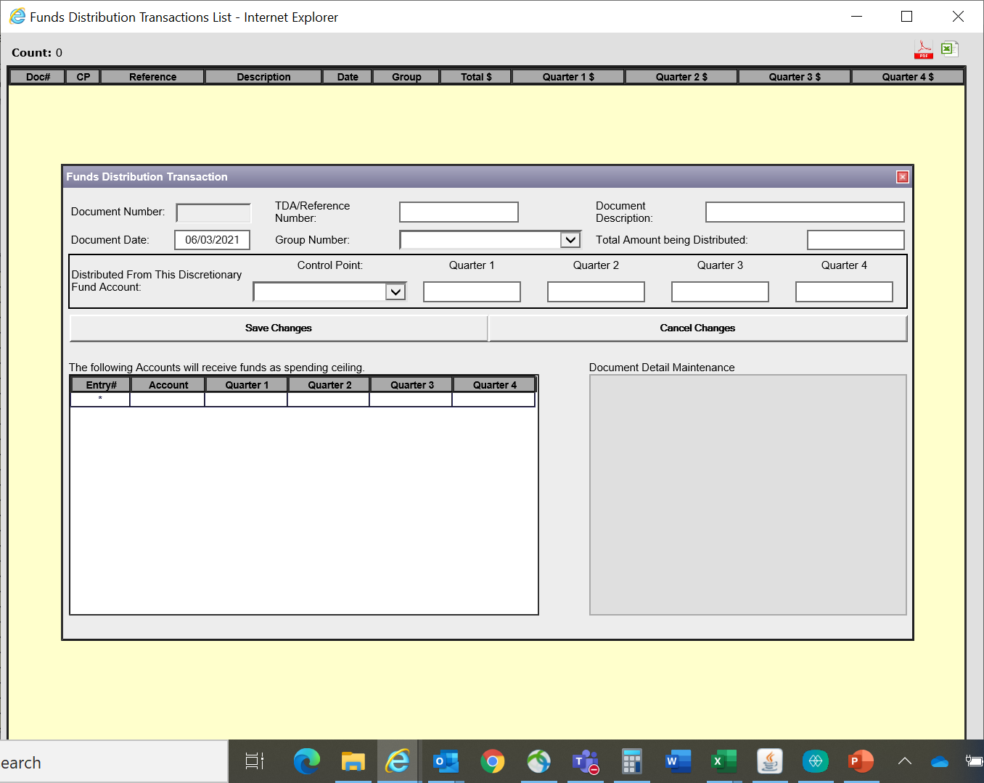
**For every Allocation Document, however many FCPs you listed, you will have that many distribution documents. For example, my CYBLR Allocation had 3 FCPs, so I will have 3 CYBLR Distributions.
Again, the document number will not be added until the document is saved.
Reference the same TDA number you used on the allocation. I also use the same date and Distribution. The group number has a drop down of numbers to select. You will select Initial funding and the total amount for this document.
Notes:
This page has a little more in-depth information needed versus the allocation page. Something to note is that for every Allocation Document you input, however many FCPs you listed on that document, you will have that many distributions. For example, my CYBLR Allocation had 3 FCPs, so I will have 3 CYBLR Distributions. The point is: in the Allocations, you’re placing the amount in an account. So I placed into 3 separate accounts: Salary, All Other, and Travel. But those funds belong into SubAccounts. So then you will then create a document that pulls from those fund control points into the investigator accounts. Reference the same TDA Number you used for the Distribution. For the ITA memo distributions, I add SAL, TRV, or AO for Salary, Travel, or All Other on my CYBLR. You will see this in the next slide.

Slide 44
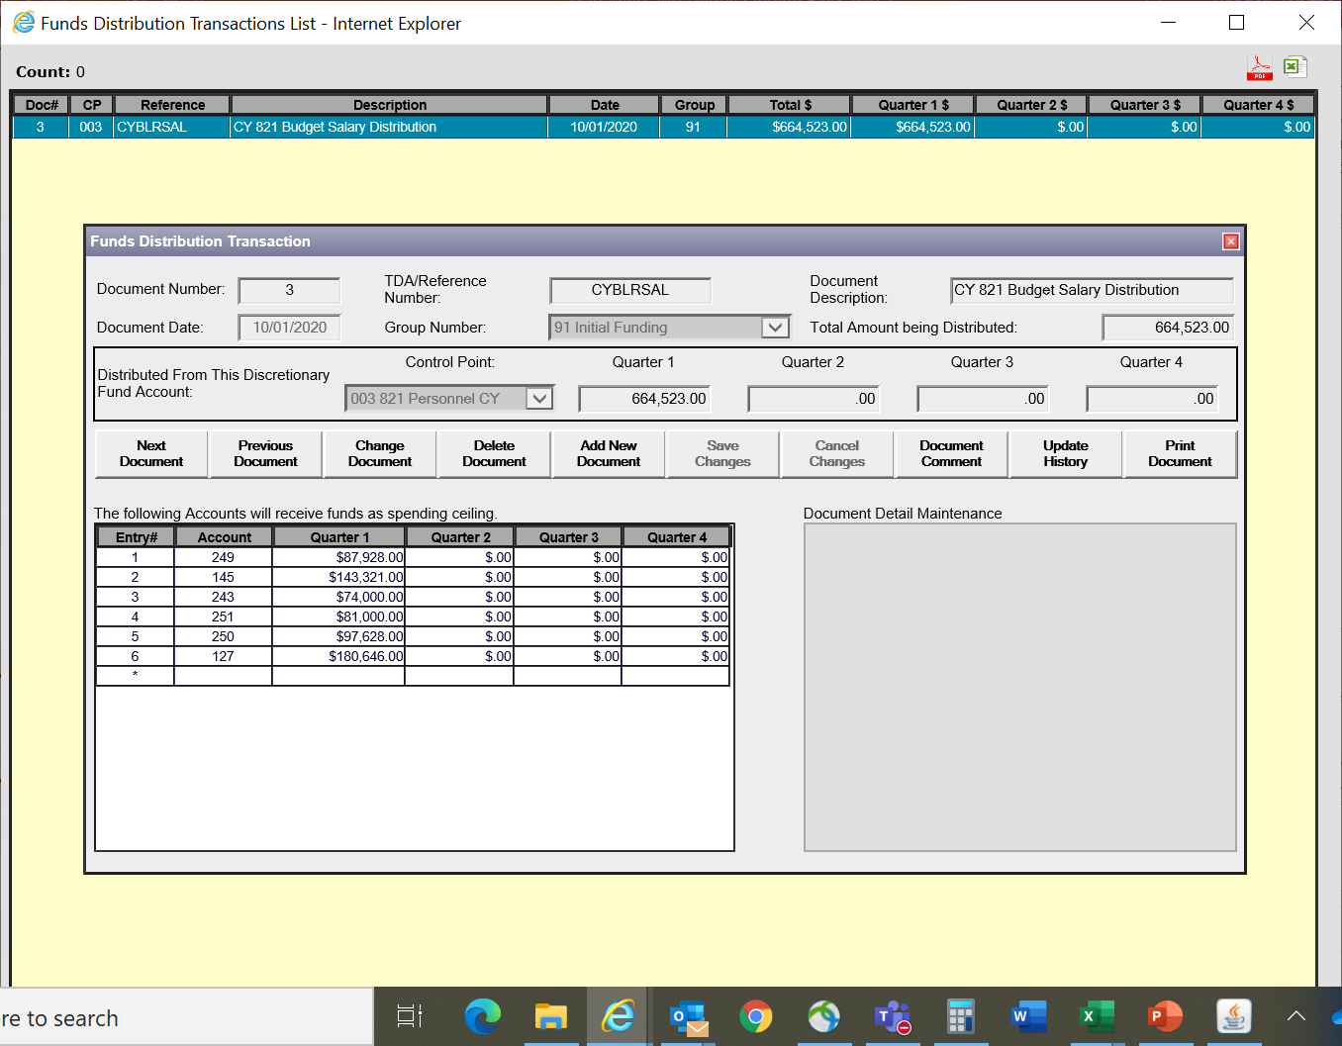
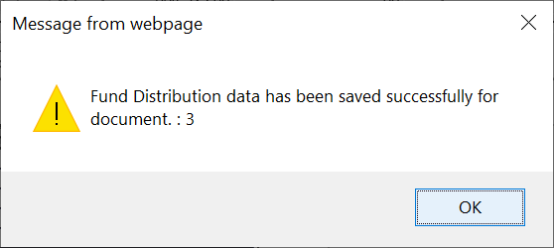
Here is my completed Distribution Document after I hit save changes. My total amount distributed was spread out amongst 6 investigator accounts.
Notes:
Here is the document all filled out. I’ve selected the Control Point I pulled from and how much. Then I went through and distributed to the different Investigator accounts the amounts that belong to them from that fund control point. Remember, the amount is the amount from the specific fund control point, so if you distributed salary and you know they also have money in all other, you will have that all other amount in a different document.

Slide 45
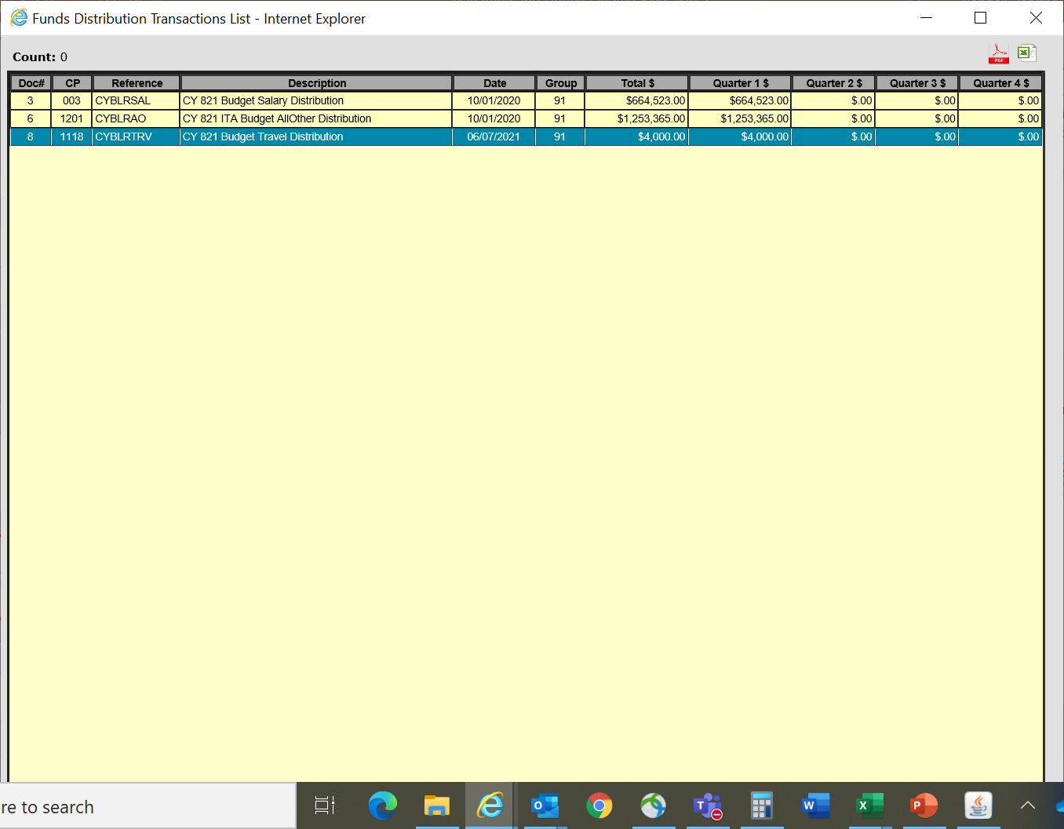
On the distributions list, you will see what I mean about 3 distributions based on the one Allocation Document I created: Salary, All Other and Travel.
Notes:
You will see the three distributions listed as follows once you’ve completed them. Those total amounts should add up to the Allocation amount for the program that you initially created and that was provided to you from the RAFT ITA Budget Memo Report.

Slide 46
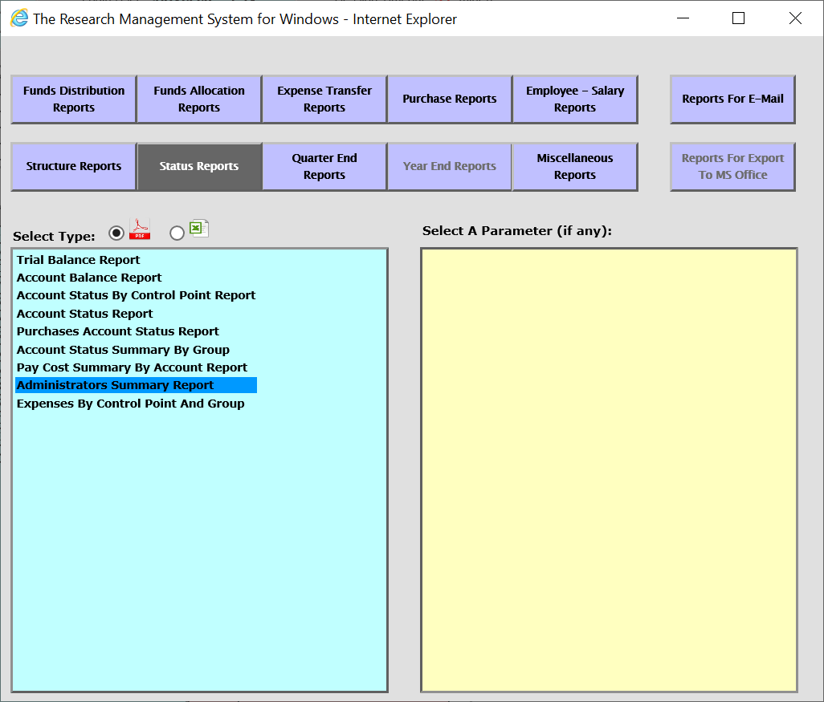
Check to see if your allocations and distribution amounts match up! The report that you’d use is the Administrator’s Summary Report. On the main RMS page, click on reports listed on the right. This box will pop up. Click on Status Reports and Select Administrators Summary Report.
Notes:
To check to see if your allocations and distribution amounts match up, the report that you’d use is the Administrator’s Summary Report. On the main RMS page, you will click on reports listed on the right. Then this box will pop up. Click on Status Reports and Select Administrators Summary Report.

Slide 47
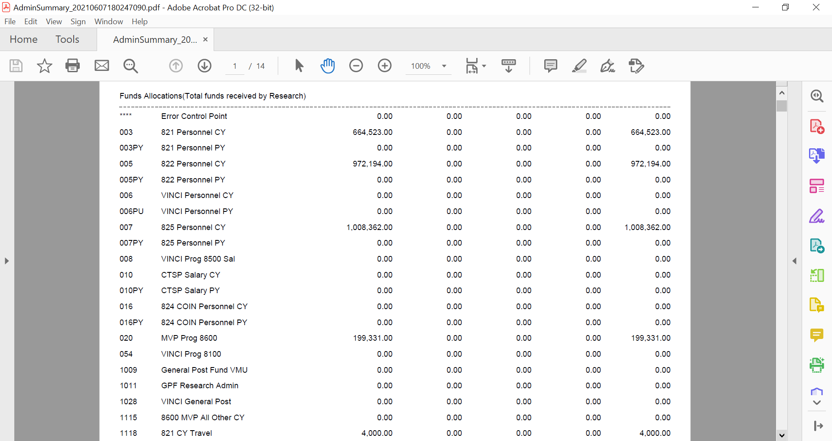
ALLOCATIONS
Notes:
You’ll see that this report is a long report and there is various information on it, but the beginning shows your Allocations and Distributions. The next few slides are to show the information that I’ve entered matches up.

Slide 48
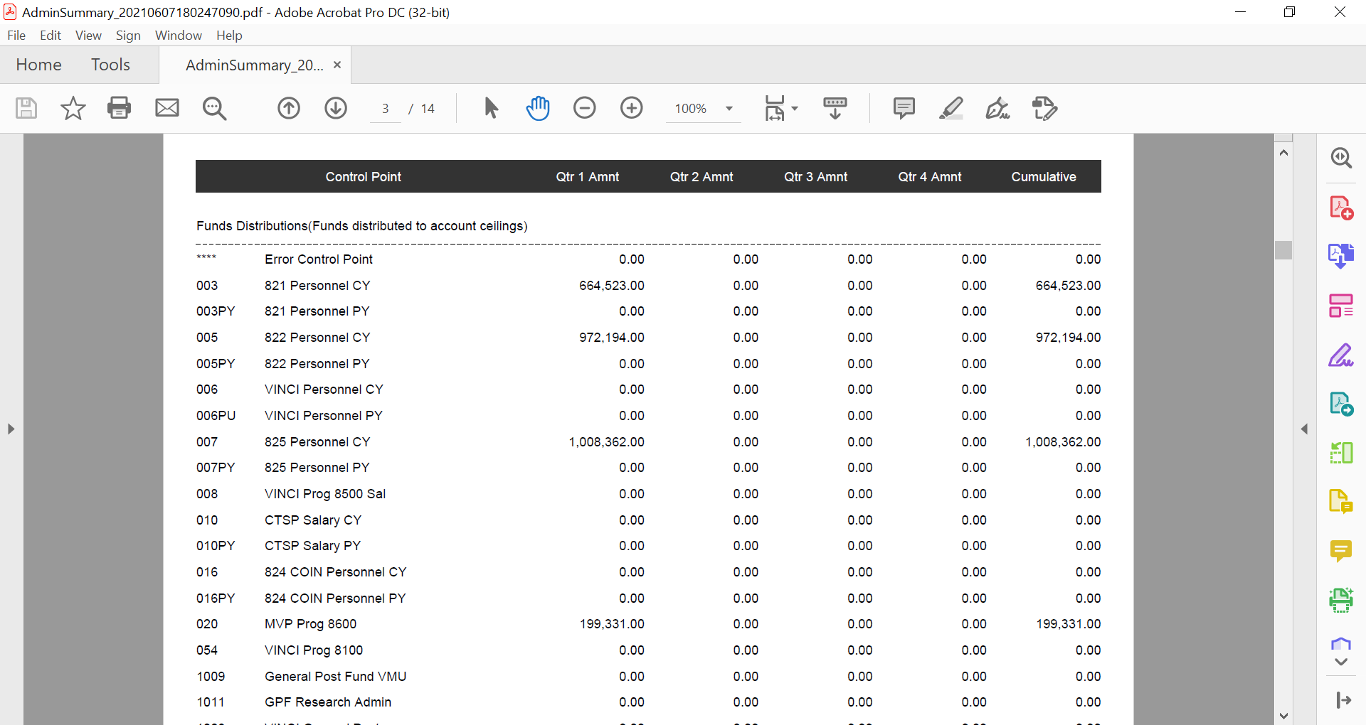
DISTRIBUTIONS

Slide 49
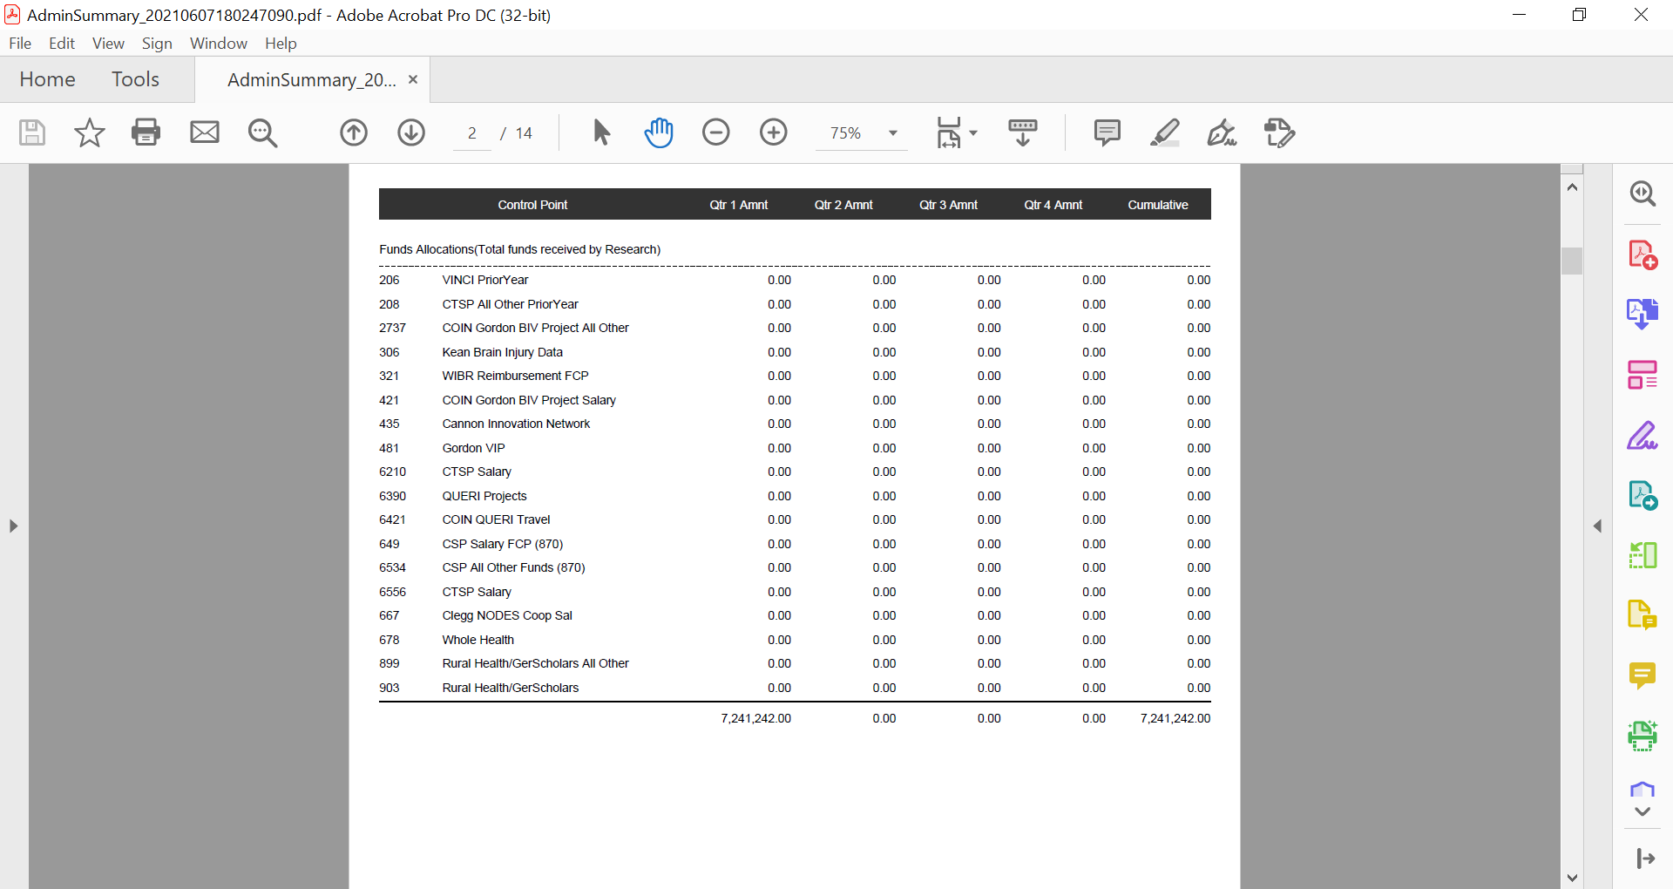
Allocations
Notes:
See if the cumulative amount from allocations matches distributions

Slide 50
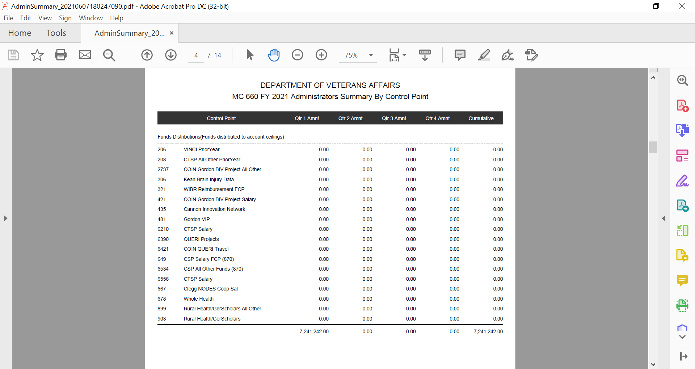
DISTRIBUTIONS
Does your cumulative amount match in Allocations and Distributions?
Notes:
Does it match?

Slide 51
Loading TDAs throughout the Year
Verify TDA’s weekly
Work with Finance to move up to the right FCP
Remember you control where the funds go not Fiscal

Slide 52
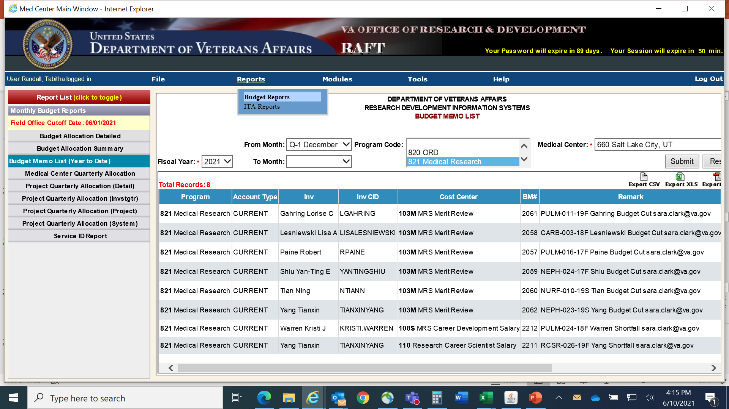
-Select Reports
-Select Budget Reports
-Select Budget Memo List
-Input your information
-Click submit
Notes:
So what do we do after the ITAs are done? A good report that I like to use is the Budget Memo List. This report shows new money sent and money taken back, which is especially helpful for finding anything not included in the ITA report. So a few months after the start of the fiscal year, around December, I look up this report. Click on Reports, Select Budget Reports, Select Budget Memo List (Year to Date), Select your fiscal year, select months if you are looking for something specific, otherwise you can leave blank. Select your program, or if you want to see them all together leave blank. Make sure its your medical center and hit submit. Then select the option for how you want to view your report. This report is good for helping you find something you’re looking for or may have missed outside of the original ITA.

Slide 53
Facility TDA | Fund | BFY | EFY | Prog Code | Date | Ledger Notation | TDA Initiator | Analyst | Qtr 3 | Total
1508 | 0161A1 | 2021 | 2022 | 8200 | 5/13/21 | A2935-R (BACHUS, KENT) NEW PROJ END DATE 30 SEP 2023 WITHDREW FY 21 $39,760 SALARY;$116,405;REDISTRIBUTED IN FY 23//DEBORAH ALLEN 2024435694 | john.verwiel@va.gov | LBELL | -156,165.00 | -156,165.00
1512 | 0161A1 | 2021 | 2022 | 8200 | 5/14/21 | A3071-S (BACHUS, KENT) FY 21 IDENTIFIED SALARY SHORTAGE (26,166)//DEBORAH ALLEN 2024435694 | john.verwiel@va.gov | LBELL | 26,166.00 | 26,166.00
1513 | 0161A1 | 2021 | 2022 | 8200 | 5/14/21 | E9275-L (RICHARDSON, RUSSELL) FY 21 IDENTIFIED SALARY SHORTAGE (21,120)//DEBORAH ALLEN 2024435694 | john.verwiel@va.gov | LBELL | 20,120.00 | 20,120.00
1514 | 0161A1 | 2021 | 2022 | 8100 | 5/14/21 | PULM-024-18F WARREN SHORTFALL SARA.CLARK@VA.GOV | john.verwiel@va.gov | LBELL | 1,302.00 | 1,302.00
1515 | 0161A1 | 2021 | 2022 | 8100 | 5/14/21 | RCSR-026-19F YANG SHORTFALL SARA.CLARK@VA.GOV | john.verwiel@va.gov | LBELL | 6,074.00 | 6,074.00
1523 | 0161A1 | 2021 | 2022 | 8500 | 5/19/21 | TRINITY CARB-002-18F FY SUPPLMT. LISA.EIBEN@VA.GOV | john.verwiel@va.gov | LBELL | 50,716.00 | 50,716.00
1524 | 0161A1 | 2021 | 2022 | 8500 | 5/19/21 | RONDINA HEMA-006-17F FY SUPPLMT. LISA.EIBEN@VA.GOV | john.verwiel@va.gov | LBELL | 44,008.00 | 44,008.00
1532 | 0161A1 | 2021 | 2022 | 8200 | 5/19/21 | B3444-I (WILDE, ELISABETH) RRD DEVELOPMENT PROJECTS ASSOCIATED WITH LIMBIC;ADD'L $$409,104 SALARY;$25K ALL OTHER//DEBORAH ALLEN 2024435694 | john.verwiel@va.gov | TBAKER | 434,104.00 | 434,104.00
Here is an example from RAFT of some TDAs of funds that have come in or requested a drawback that is not part of the initial ITA and therefore would need separate Allocations and Distributions input.
Notes:
Here is an example of the TDA lists that my finance office sends to me requesting to know which fund control point to distribute to. As we established in our last training session, other facilities do different things, or some people have access to this information themselves without their finance involved. My finance reaches out to me with a list of undistributed TDAs and asks where to place them. These TDAs are of funds that have come in or requested a drawback that are not a part of the original ITA and need to have new allocation and distribution documents created for them.

Slide 54
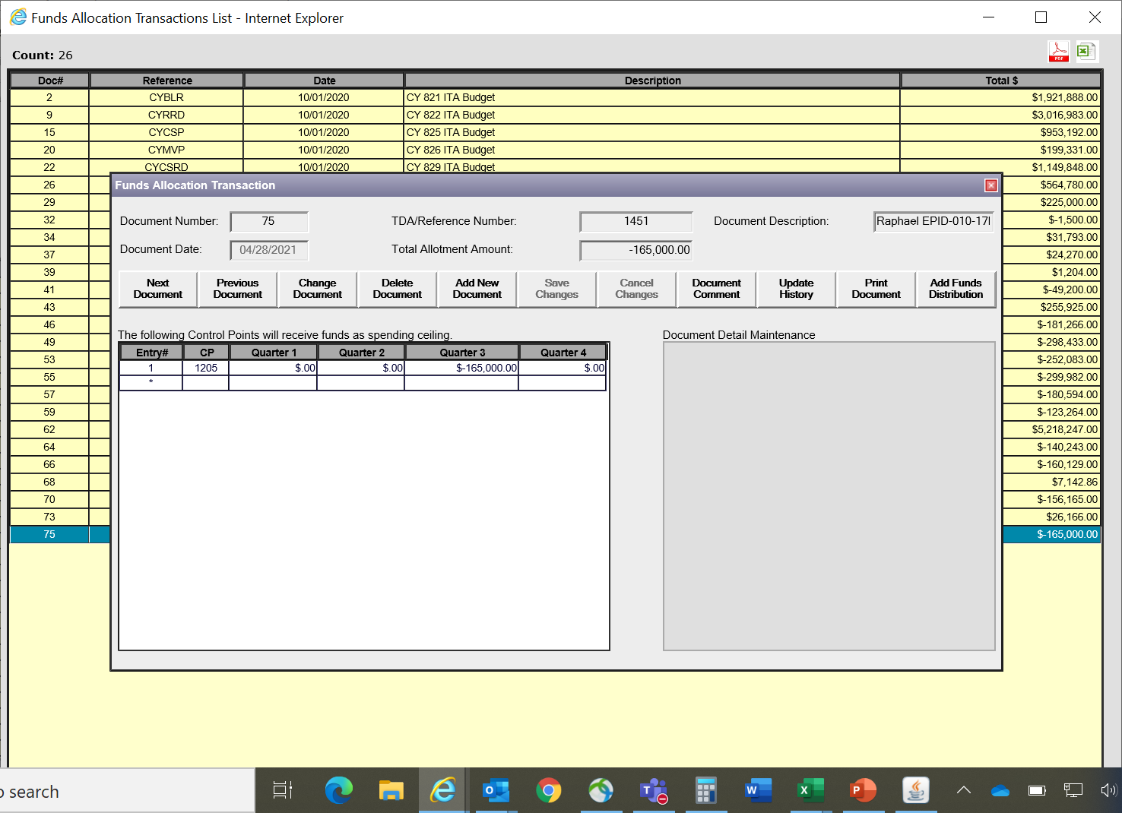
This is a withdrawal TDA request.
I referenced the specific TDA number for my station and the date that the TDA came. Since it is a withdrawal make sure you use the minus before the amount in BOTH spots you use amounts.
Notes:
It is pretty much the same process as the ITA memo distribution at the beginning, but you must decide your preference on how you want to do it moving forward. If you have a lump of TDAs that come in, do you want to lump the same programs together to do less documents or do you want to separate them out by TDA to track them that way? Here is an example of a withdrawal. This PI went to a different station, so the money is going away, so make sure you use the minus in your sections.

Slide 55
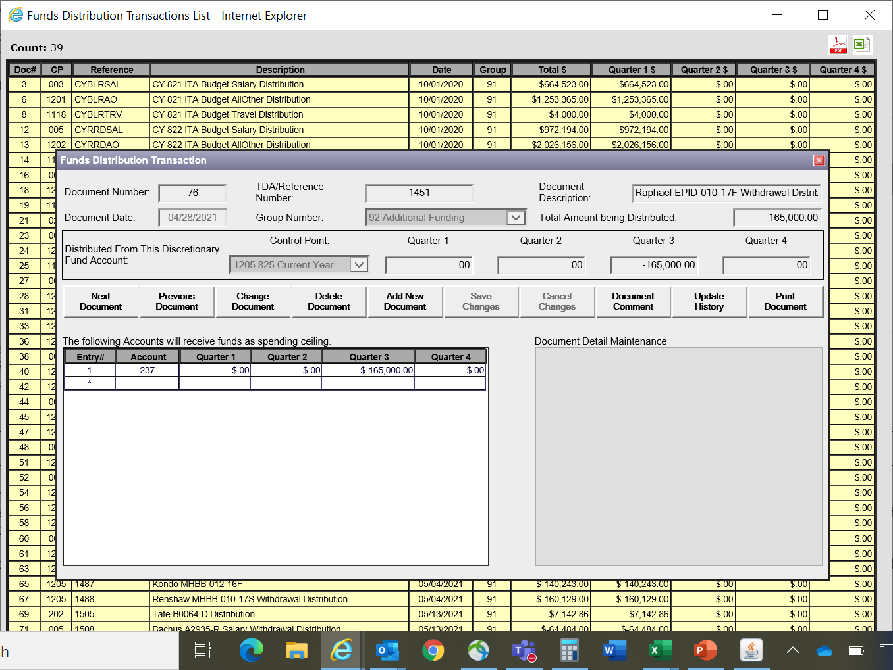
In distributions there are three spots for amounts to be placed. Make sure they all match or add up
Notes:
For the distributions, make sure your quarters are matching up from where you placed the distribution in allocations. And you can see there are three spots for amounts. They all have to match or add up, or you will get an alert, so have your minus amount in each spot and the totals add up.

Slide 56
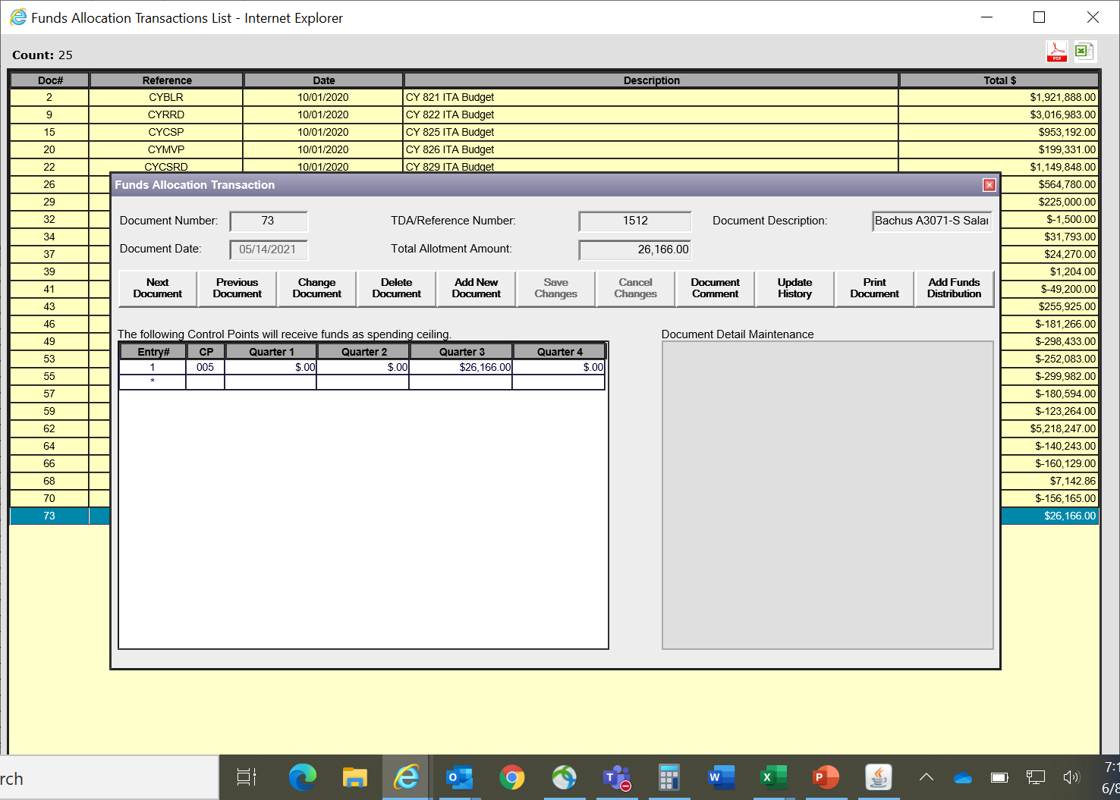
Example of Salary Shortfall provided by service and sent later in the fiscal year
Notes:
Here is an example of a salary short fall sent due to the RCS/CDA reports we do in April/May each year. The formula you fill out and send in shows how much you need to cover the salary.

Slide 57
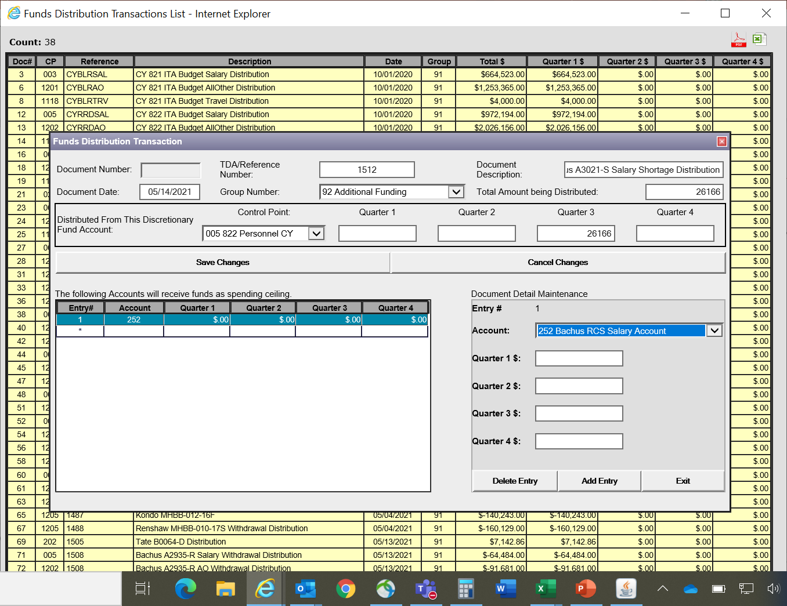
Input the TDA number it came in on, reference it as a shortfall, the date it came in, mark it as additional funding in your group number options, the amount being sent, and attach it to the account it belongs to.
Notes:
Here is the distribution example. I mark it as additional funding and that it was a shortfall or a shortage from salary and attach it to the account it belongs to.

Slide 58
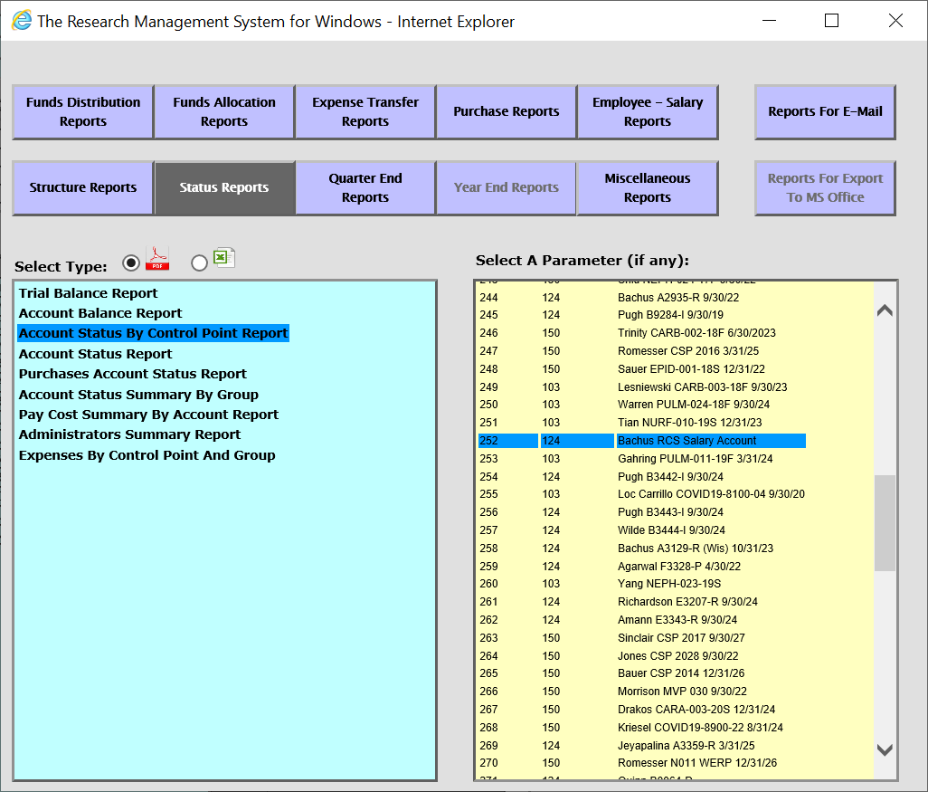
-Click on Reports on the main page and this will pop up
-Select Account Status by Control Point Report
-Select the account you want to see.
Notes:
To check to see how it looks in the Investigators account after you’ve placed both the allocation and distribution in, you can click reports on the main page, Select Account Status by Control Point Report, and select your Investigator account.

Slide 59
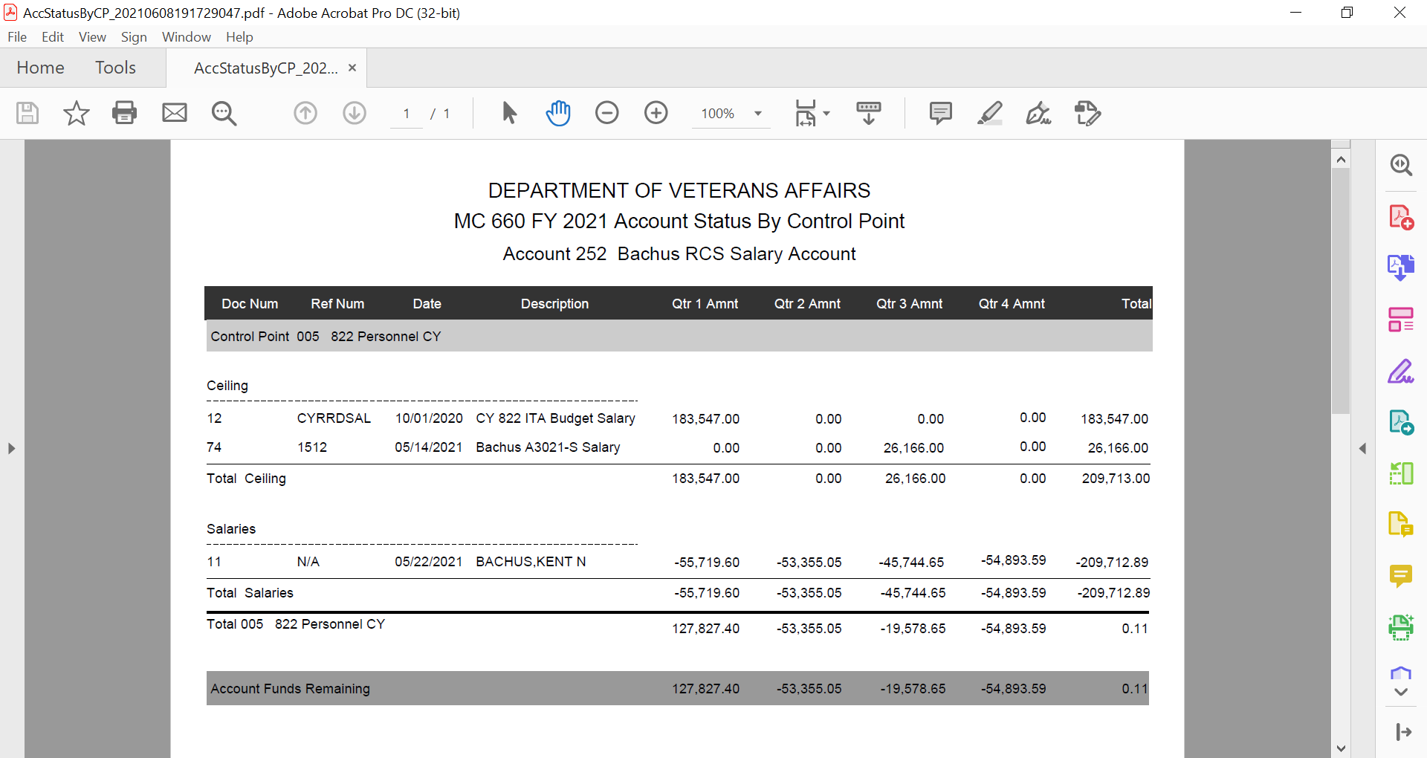
ITA
Add’l TDA
Projected Salary
Remaining Balance
Notes:
In the report you will see what came on the ITA memo and the additional funds that came in. Then the projected salary that will be charged for the PI and the remaining balance.

Slide 60
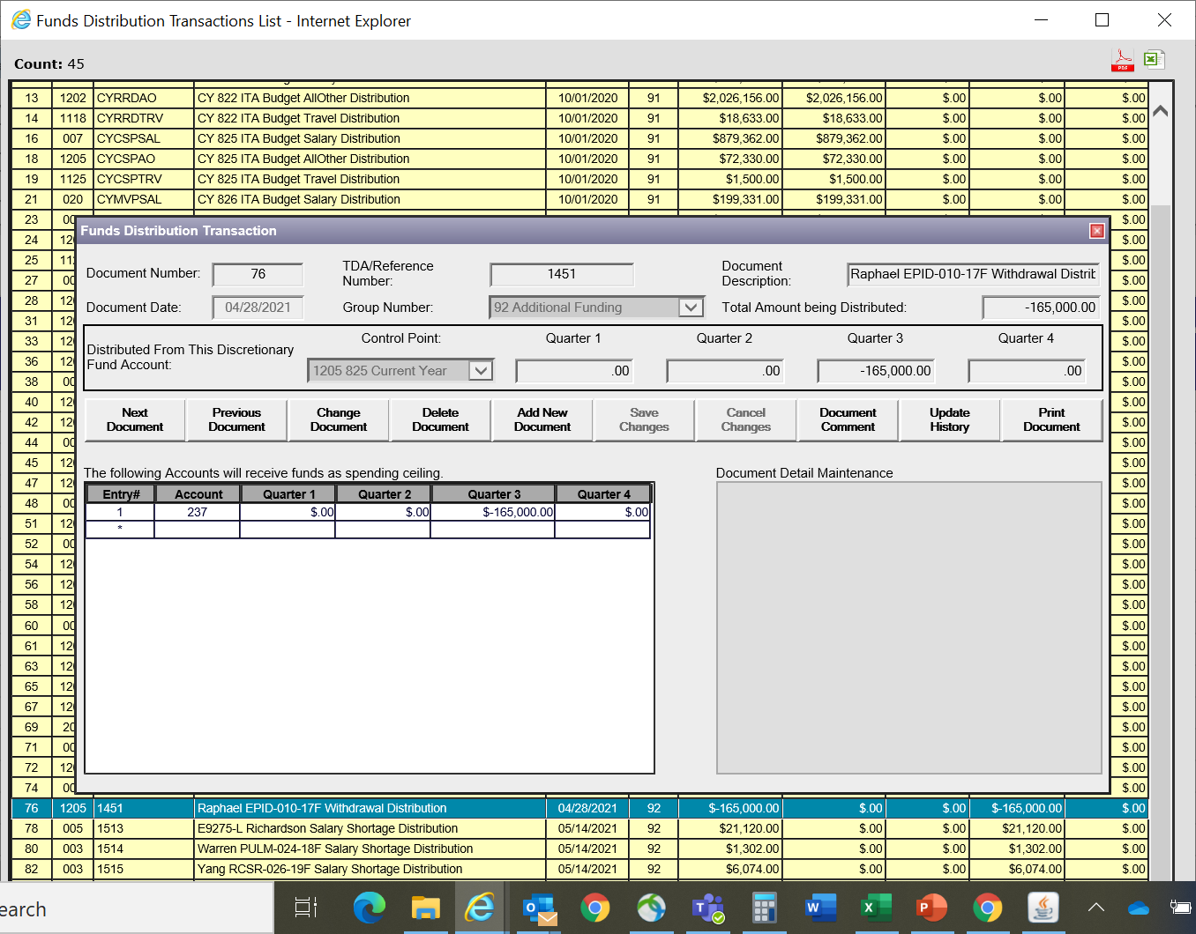
Example of TDA Withdrawal
Notes:
Let’s take a look at another way to check if funds have been placed in your fund control place after you have told finance or done what you needed to do to place the TDAs into your fund control points. Here is a withdrawal of funds we saw earlier.

Slide 61
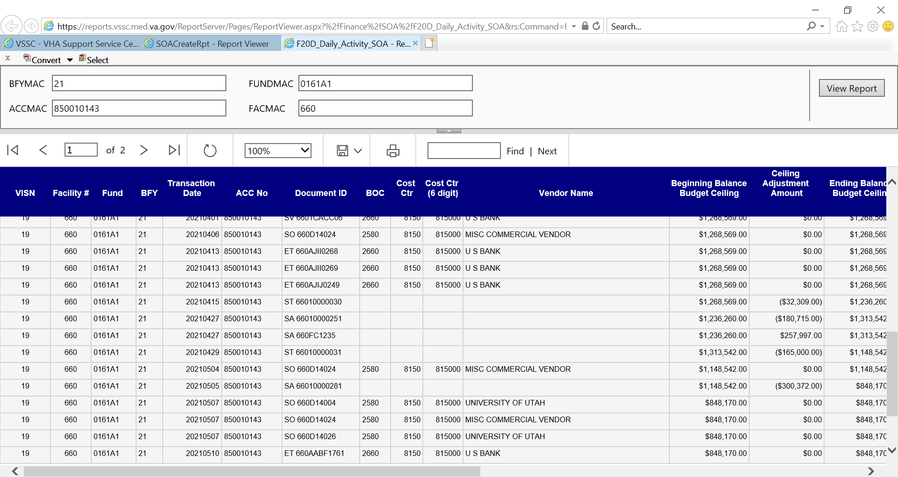
Funds withdrawal
Notes:
Here is the VSSC, which we went over in our previous training session. I searched on the Status Allowance and pulled up the F20 Daily Activity report for the fund control point that the previous withdrawal was supposed to come from, and we can see it here. One thing to keep in mind is if a few TDAs were distributed into the same account on the same day, they may have an accumulative amount, so know what you’re looking for. For example, two lines below our first example withdrawal, I see another withdrawal. I personally know that is for two project modifications and redistributions that were requested. The amounts for their TDAs equal the withdrawal amount listed.

Slide 62
Movement of Ceilings
Throughout the year, you may need to move ceilings amongst your FCPs in a Program. This may be due to a salary or all other FCP being in a deficit that needs to be corrected or it may be so you can do cost transfers to close out PY.
In order to do this, you will use the Funds Allocation and Funds Distribution items in WinRMS.
You will first want to Add a Funds Allocation to show the movement of funds from the FCPs. The total amount of the Funds Allocation will be $0 as you will be moving funds from one FCP to the other.
Once the Funds Allocation is complete, you will need to do a Funds Distribution to an Account in WinRMS. For this, I use an admin account that is set-up for these types of transactions. Each FCP will need its own Funds Distribution to that account.

Slide 63
Movement of Ceilings (Allocation)

Slide 64
Movement of Ceilings (Distribution)

Slide 65
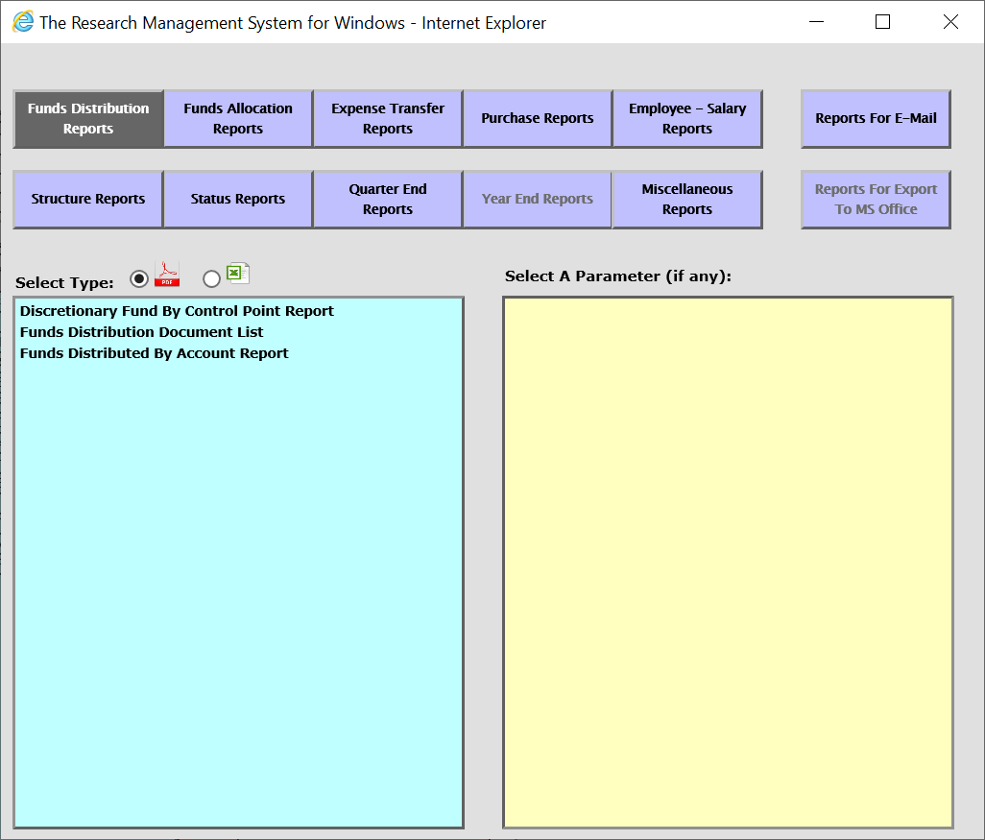
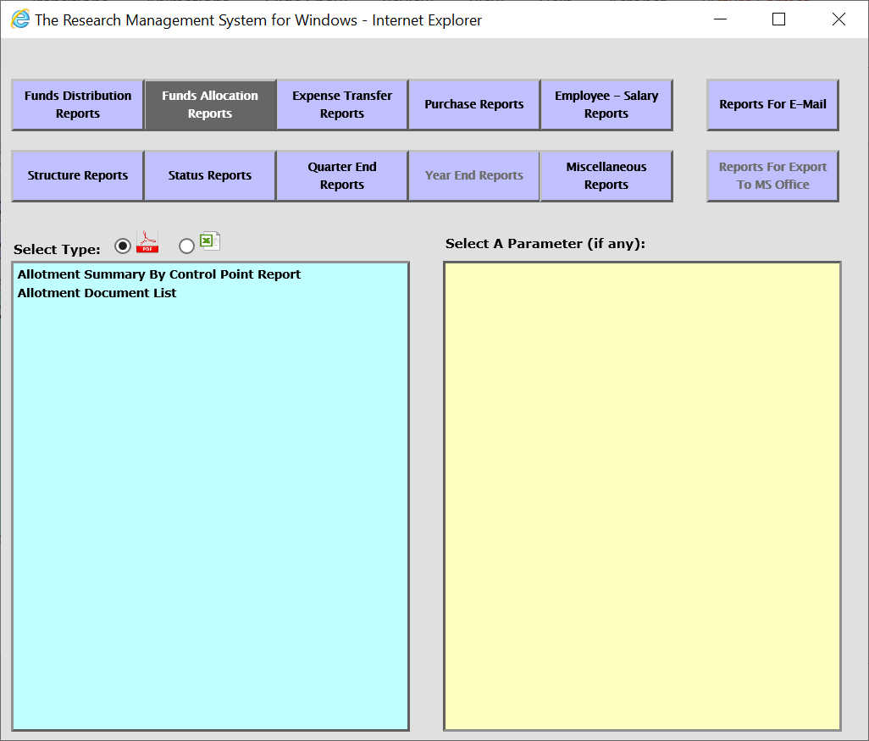
Here are a few report options that pertain to everything we’ve just gone over
Notes:
And here are two menu options of reports to go over to look up your Allocations and Distributions

Slide 66
Conclusions
Allocate to an FCP and Distribute to an account
Daily Management of TDAS – Use RAFT or AACS to Access data
Balance your Ceilings at least once a month
Reminder Session 2 is tomorrow

Slide 67
Availability of Recording
A recording of this session and the associated handouts will be available on ORPP&E’s Education and Training website approximately one-week post-webinar
An archive of this and other webinars can be found here: https://www.research.va.gov/programs/orppe/education/webinars/archives.cfm

Slide 68
Questions??

